Slide 1
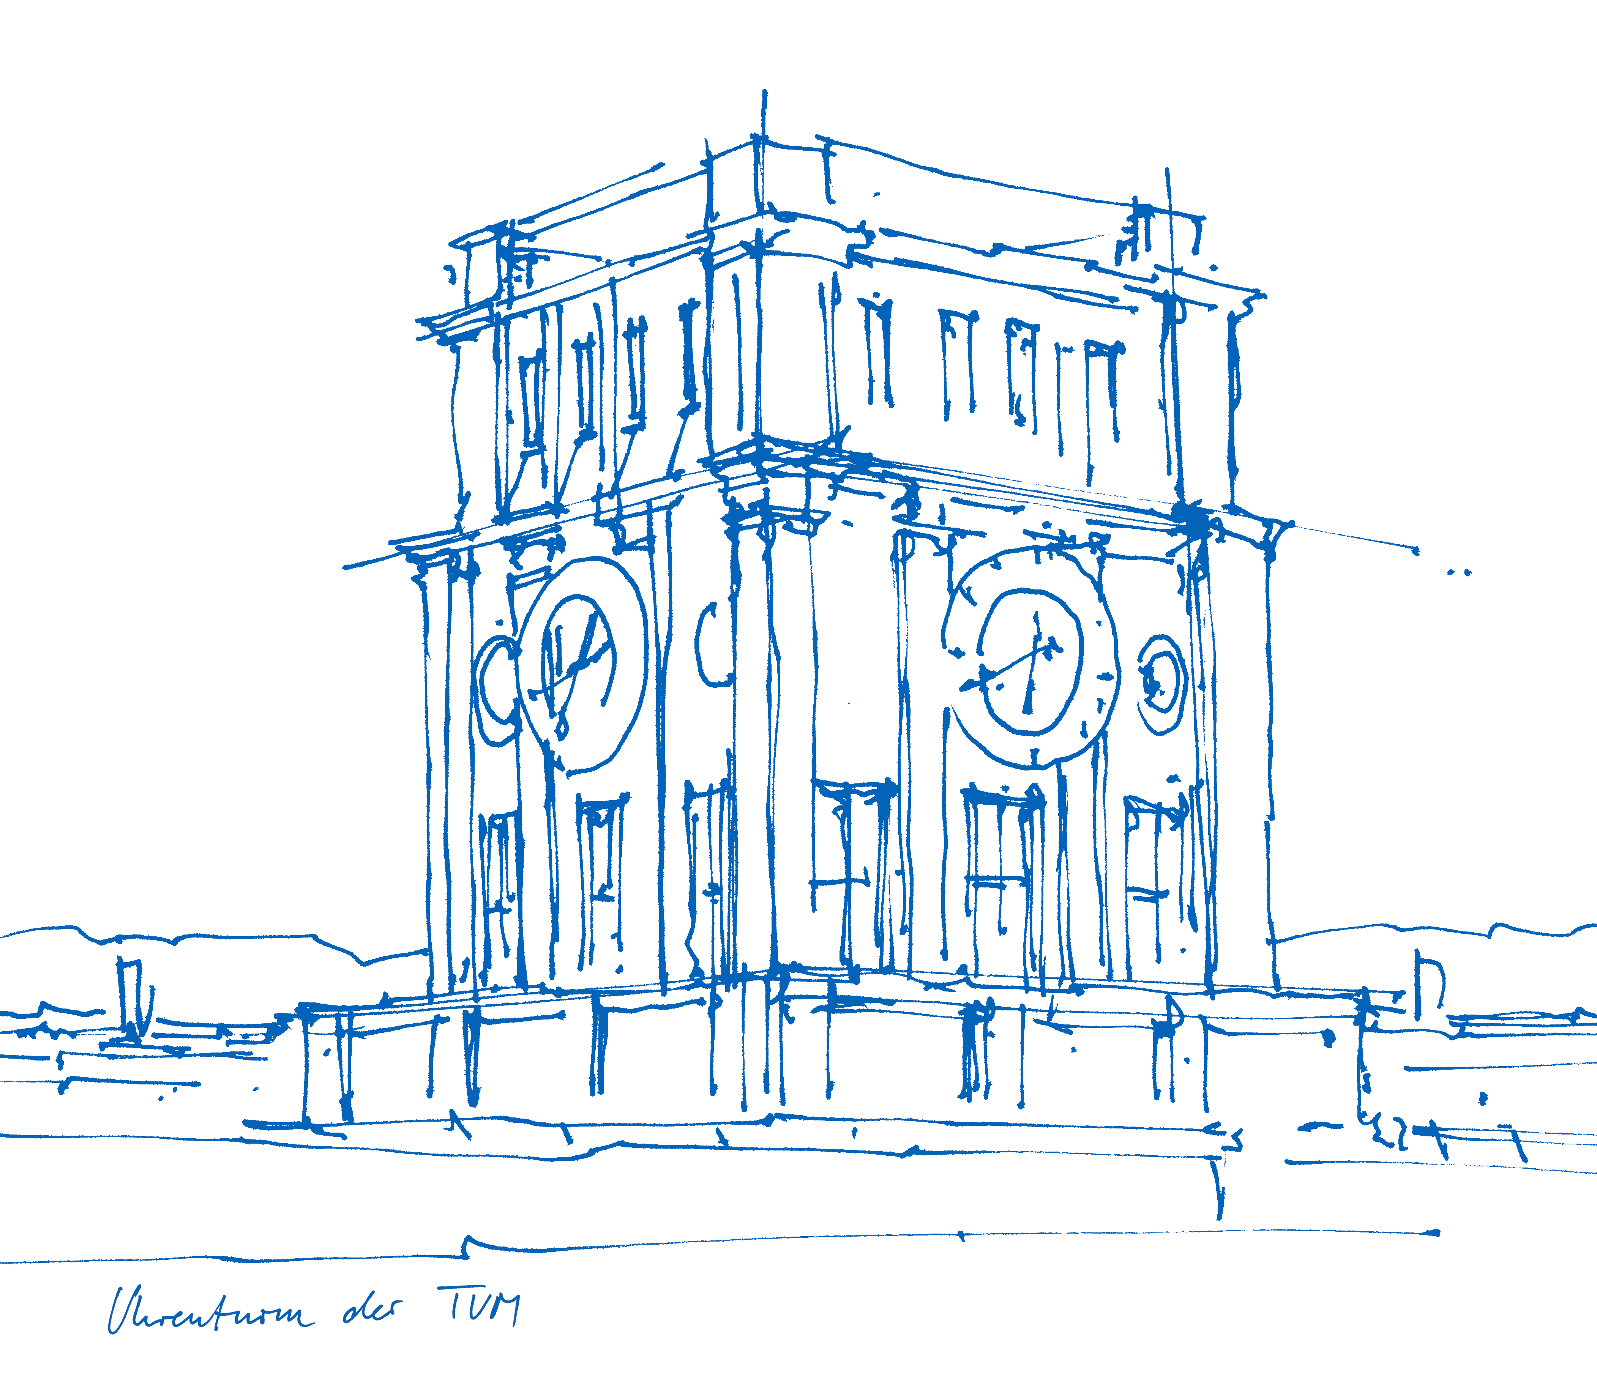
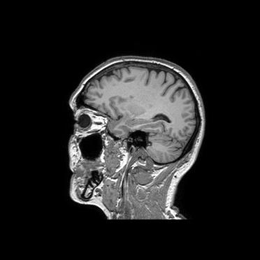
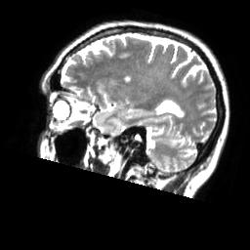
Machine Learning in Medical Imaging SS16
Project Presentation: U-Net Implementation
Claus Meschede, Leonard Rychly
Technische Universität München
Fakultät für Informatik
Chair for Computer Aided Medical Procedures & Augmented Reality
München, July 18, 2016

Slide 2
Outline
Project description
Issues
Results
Summary

Slide 3
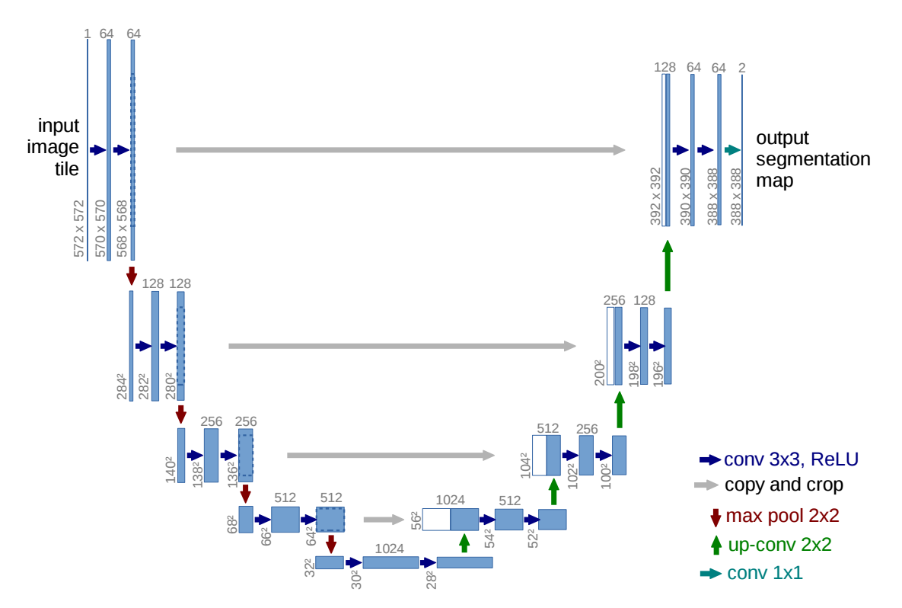
Project description – U-Net I
Main feature: skip connections for reusing finer feature maps.
Used for medical image segmentation.
Ronneberger, Olaf, Philipp Fischer, and Thomas Brox. "U-Net: Convolutional Networks for Biomedical Image Segmentation." Medical Image Computing and Computer-Assisted Intervention–MICCAI 2015. Springer International Publishing, 2015. 234-241.

Slide 4
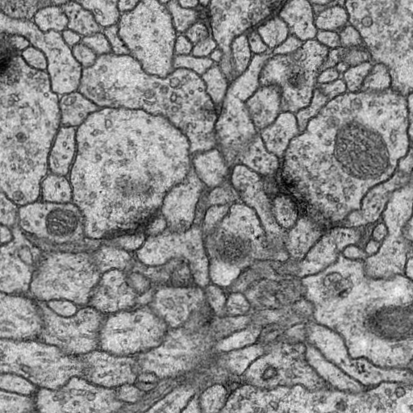
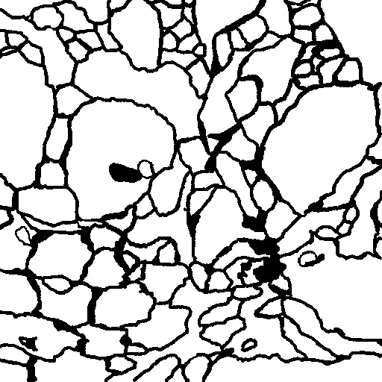
Project description – U-Net II
Main feature: skip connections for reusing finer feature maps.
Used for medical image segmentation.
Ronneberger, Olaf, Philipp Fischer, and Thomas Brox. "U-Net: Convolutional Networks for Biomedical Image Segmentation." Medical Image Computing and Computer-Assisted Intervention–MICCAI 2015. Springer International Publishing, 2015. 234-241.

Slide 5
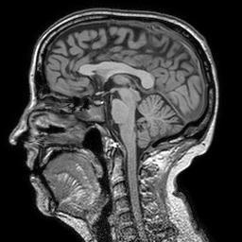
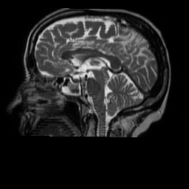
Project description – Idea
Adapt U-Net Architecture to predict one modality given another.
Raw volumetric data is available (Brain MRI)

Slide 6
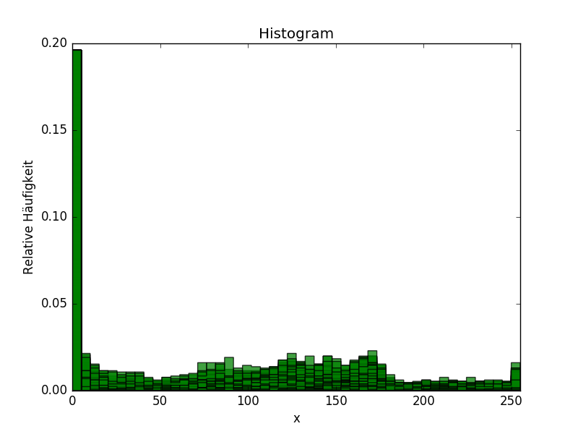
Project description – Image Generation
Generate 2D Images from raw volumetric data.
Normalize gray scale images.

Slide 7
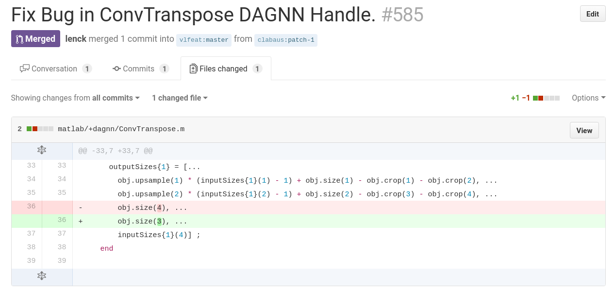
Issues – Transposed Convolutions Bug

Slide 8
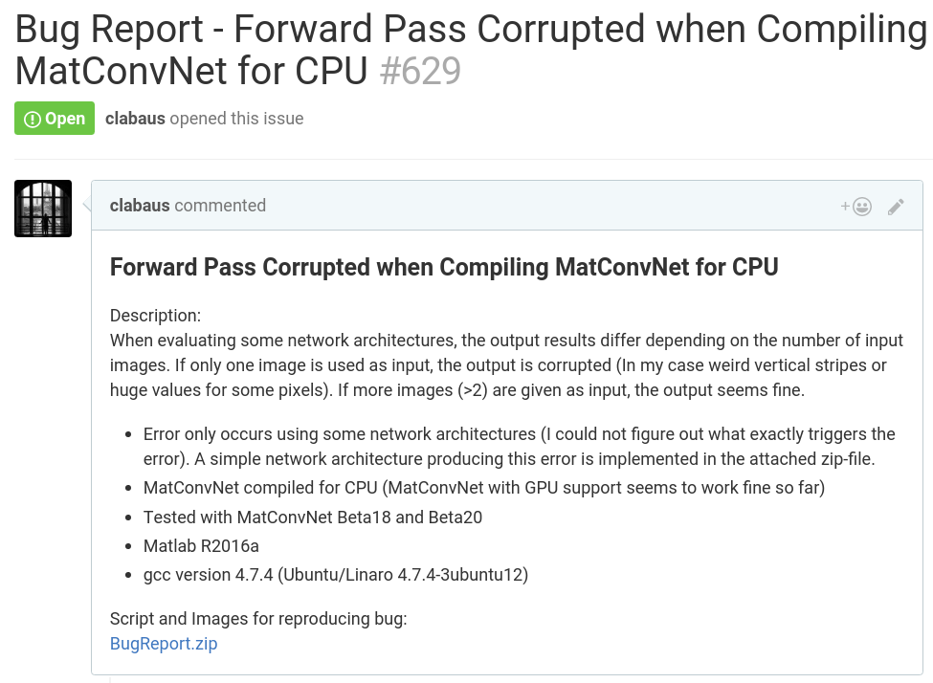
Issues – Forward Pass Bug

Slide 9
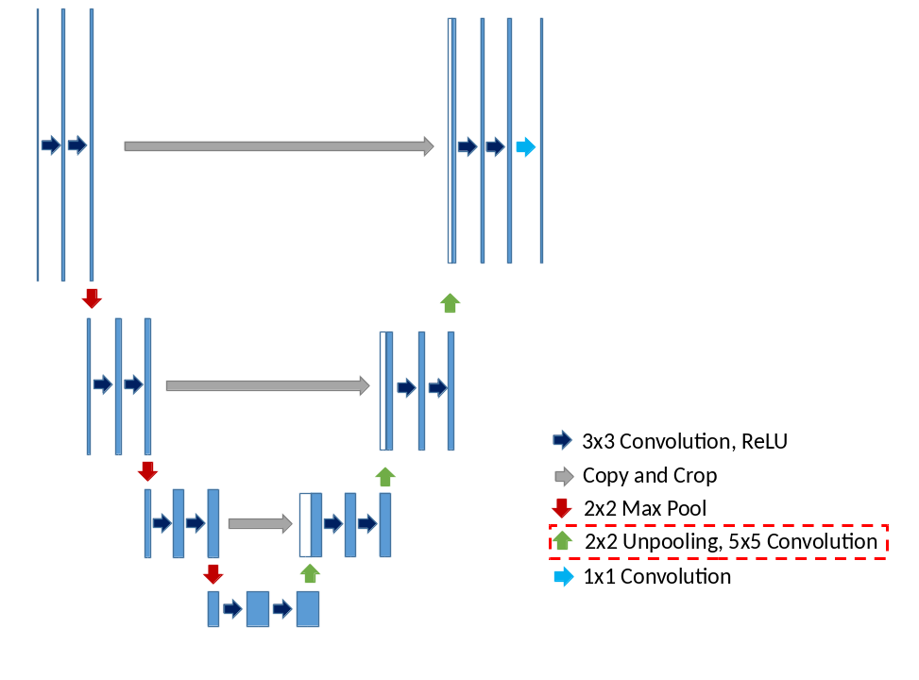
Results – U-Net with Unpooling

Slide 10
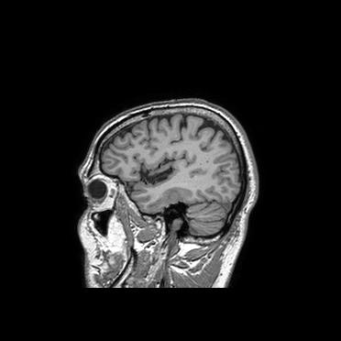
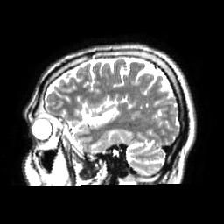
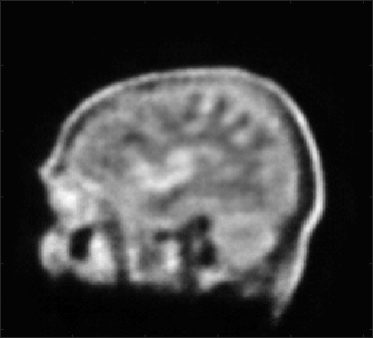
Results – U-Net with Unpooling
Test Image
Target Image
Output Image
# of images: 8000
# of epochs: 22
Learning rate: 1e-7
Weight decay: 0.01
Momentum: 0.9

Slide 11
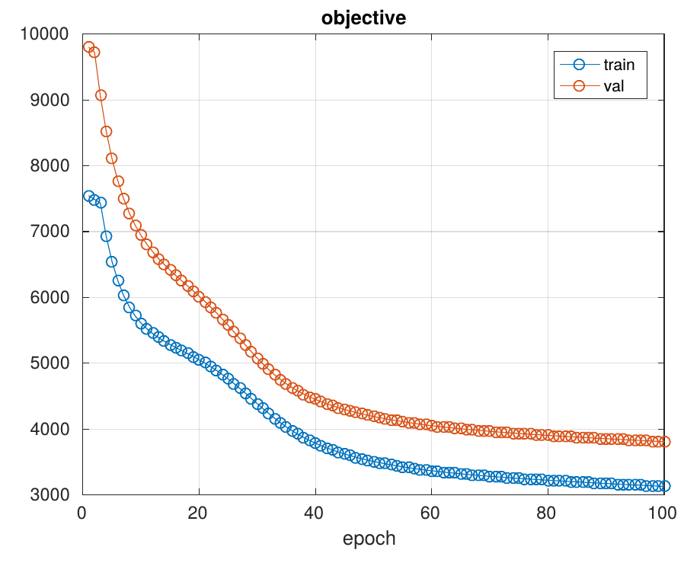
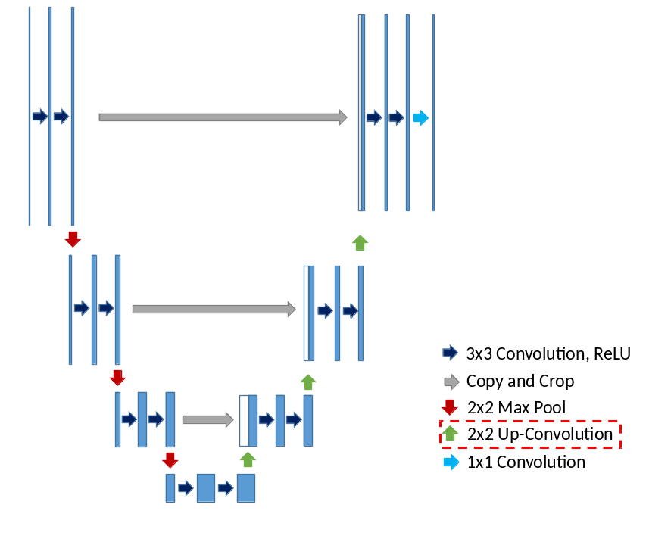
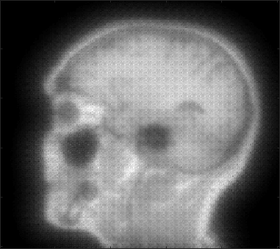
Results – U-Net with Up-Convolutions
# of images: 15
Example Output
Not trained with all available images yet!

Slide 12
Summary
What we have learned:
Using state-of-the-art software in development can be cumbersome:
→ Importance of systematic troubleshooting
Implementing CNNs
Training CNNs
Optimize learning parameters
Conclusion:
U-Net capable of roughly predicting the target modality.
Further testing needed for performance evaluation …
Larger training set
Up-Convolutions ↔ Unpooling
Increasing depth of U-Net
Convolutions using padding
Cut input images to output shape
→ Compare performance of U-Net with other CNNs

